Slide 1
Python List
4110E219 喬安蒂

Slide 2
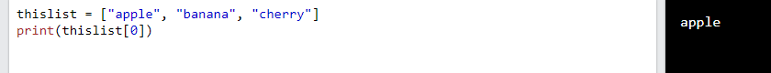
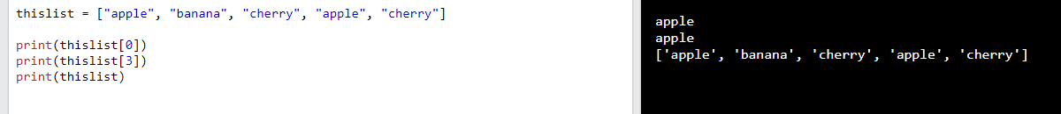
List
Lists are used to store multiple items in a single variable.
Lists are created using square brackets
Example
Allow Duplicates
Since lists are indexed, lists can have items with the same value:
Example

Slide 3
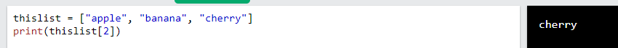
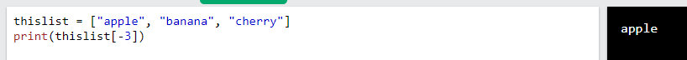
Access Items
List items are indexed and you can access them by referring to the index number:
Example
Negative Indexing
Negative indexing means starting from the end
-1 refers to the last item, -2 refers to the second last item, etc.
Example

Slide 4
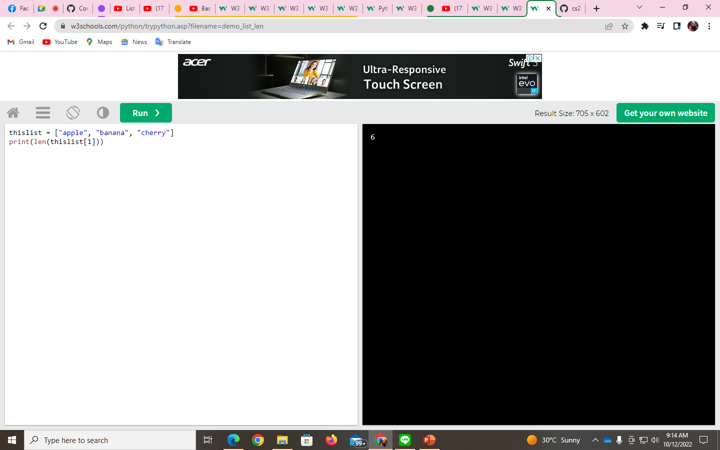
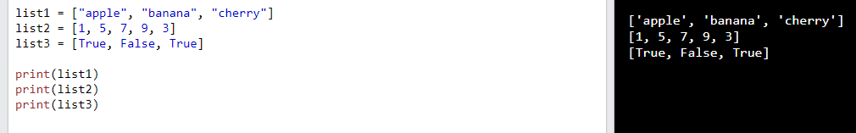
List Length
To determine how many items a list has, use the len() function:
Example
List Items - Data Types
List items can be of any data type:
Example
String, int, and boolean data types:

Slide 5
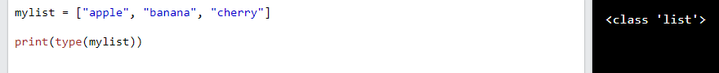

type()
From Python's perspective, lists are defined as objects with the data type 'list':
<class 'list’>
Example
The list() Constructor
It is also possible to use the list() constructor when creating a new list.
Example

Slide 6
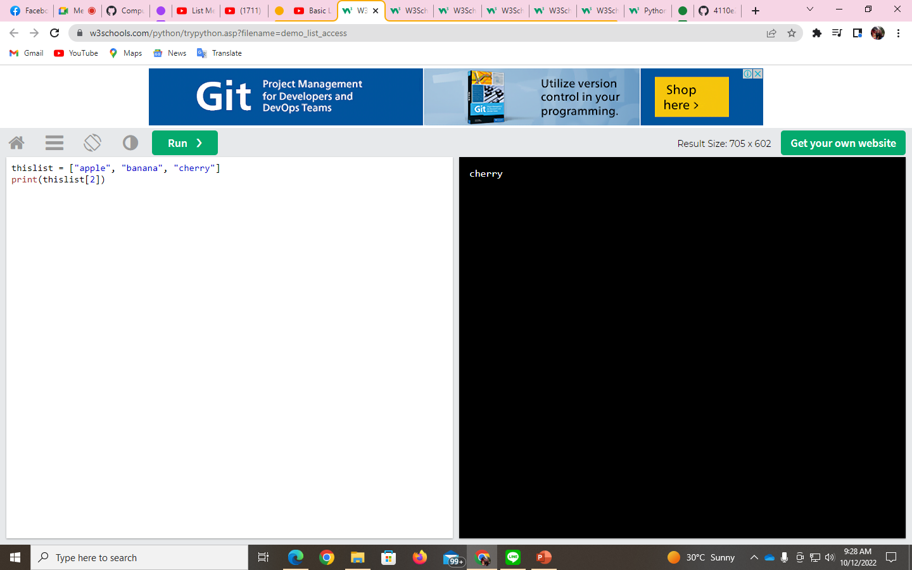
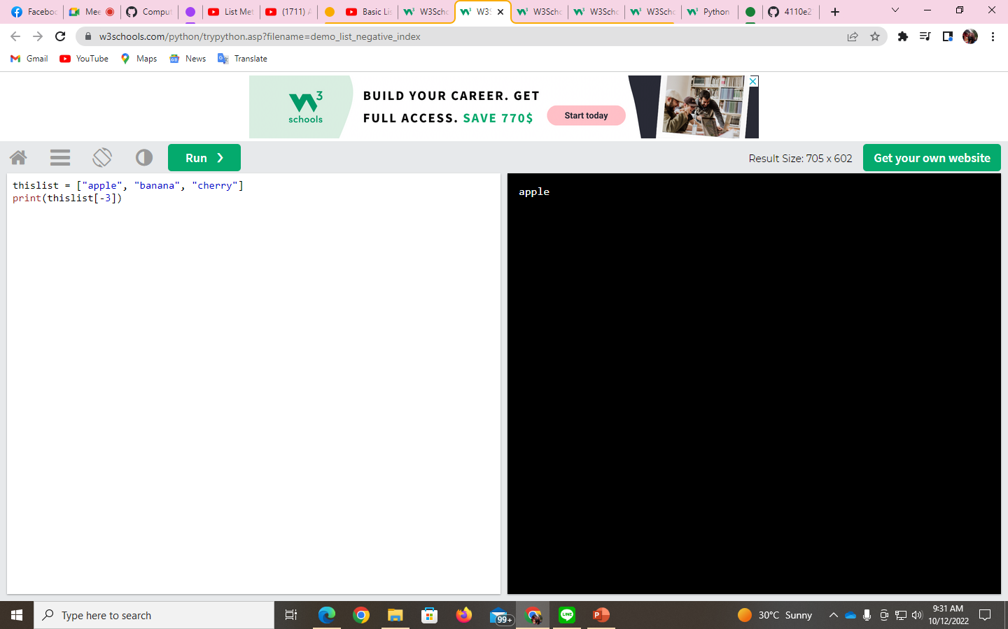
Python - Access List Items
Access Items
List items are indexed and you can access them by referring to the index number:
Example
Negative Indexing
Negative indexing means starting from the end
-1 refers to the last item, -2 refers to the second last item, etc.
Example

Slide 7
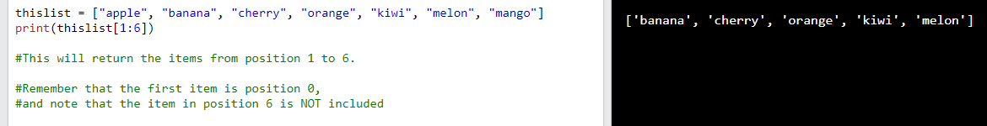
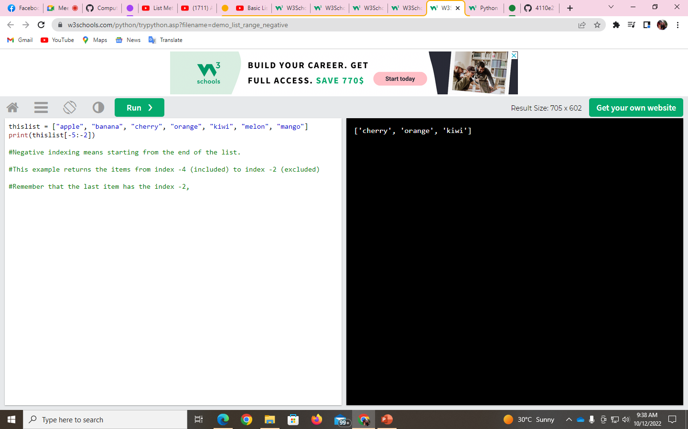
Range of Indexes
You can specify a range of indexes by specifying where to start and where to end the range.
When specifying a range, the return value will be a new list with the specified items.
Example
Range of Negative Indexes
Specify negative indexes if you want to start the search from the end of the list:
Example

Slide 8

Check if Item Exists
To determine if a specified item is present in a list use the in keyword:
Example

Slide 9
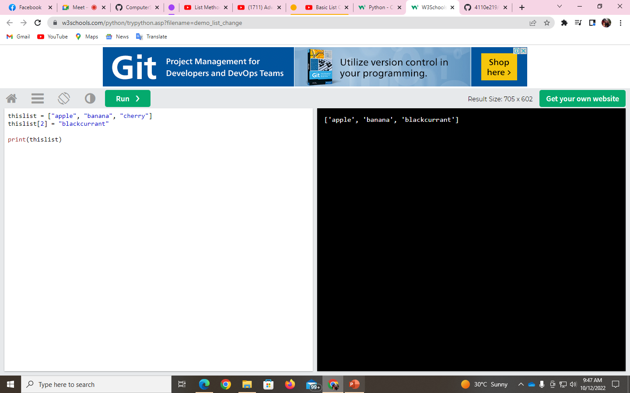
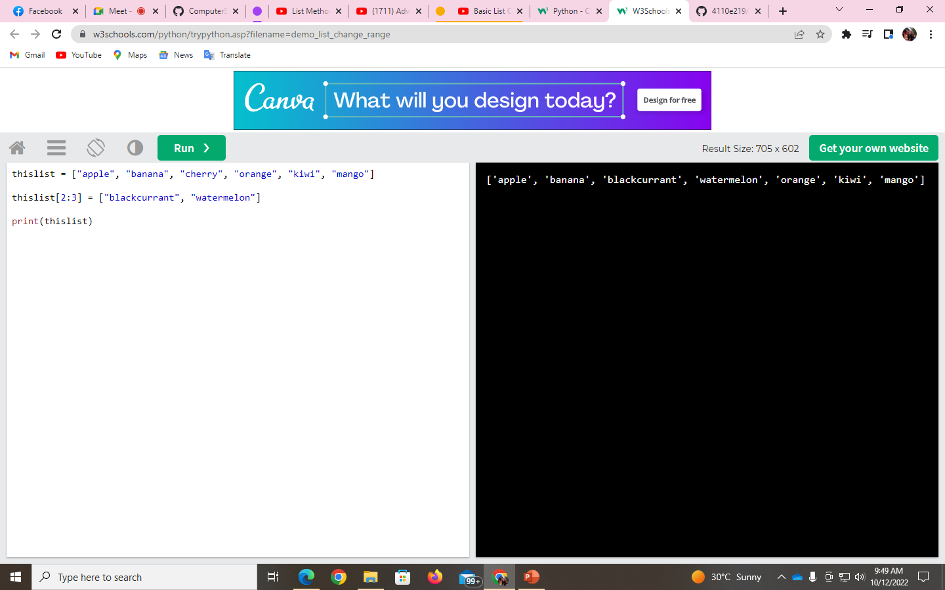
Python - Change List Items
Change Item Value
To change the value of a specific item, refer to the index number:
Example
Change a Range of Item Values
To change the value of items within a specific range, define a list with the new values, and refer to the range of index numbers where you want to insert the new values:
Example

Slide 10
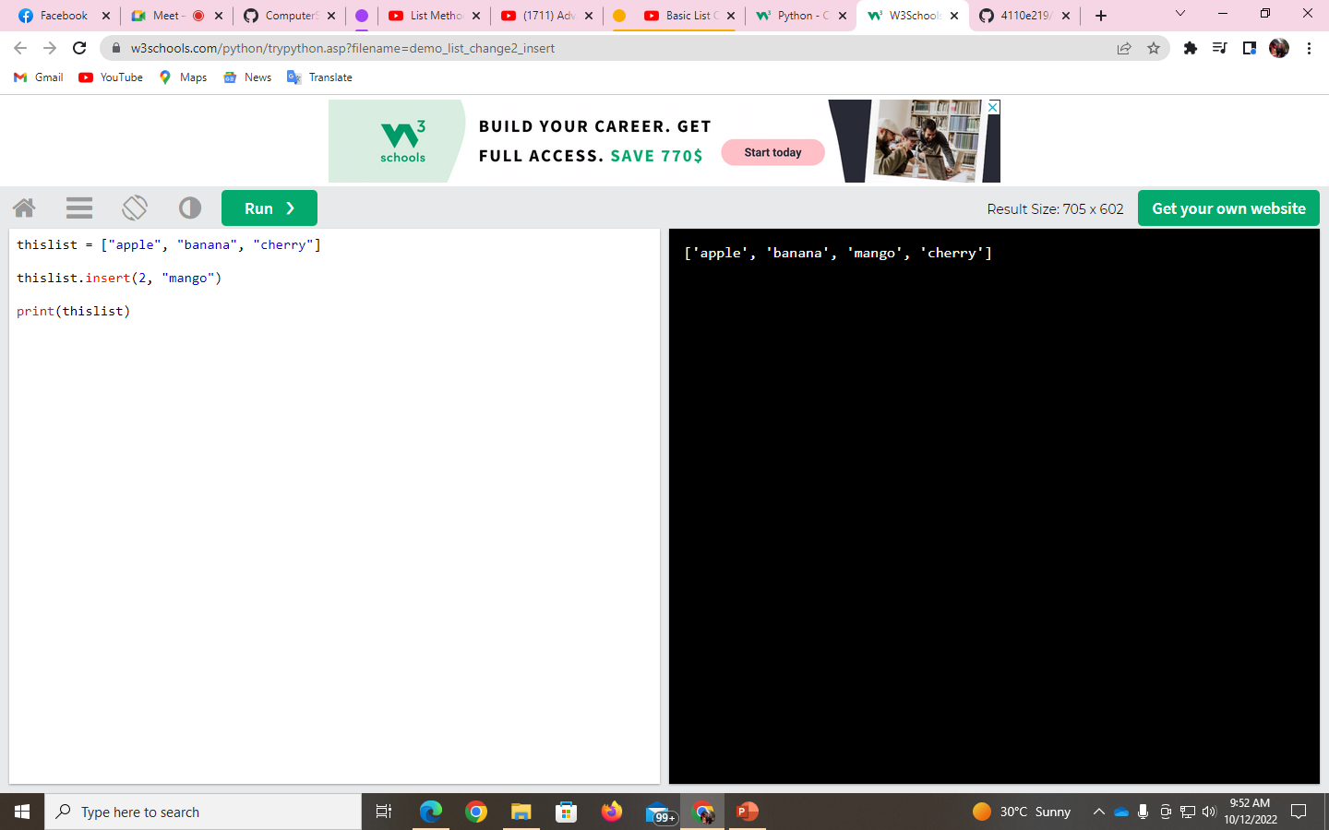
Insert Items
To insert a new list item, without replacing any of the existing values, we can use the insert() method.
The insert() method inserts an item at the specified index:
Example

Slide 11
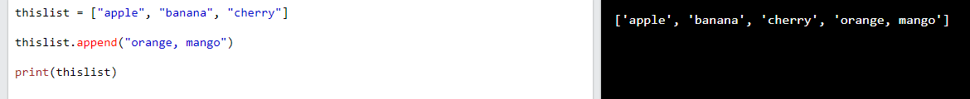
Python - Add List Items
Append Items
To add an item to the end of the list, use the append() method:
Example

